Slide 1
Top Three Exercise

Slide 2
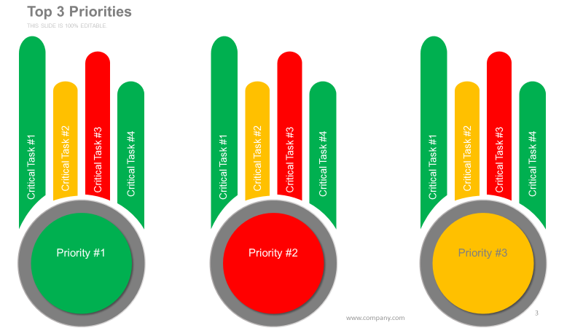
Instructions
Using the template on the next slide:
Identify the top three priorities for the business for the next quarter
List the most important four tasks for each priority
The length of the task bar indicates the effort required for that task
Color code the progress of each of the three priorities
Green is on track
Yellow is at risk
Red is behind
Color code the progress of each task
Pin your sheet to the wall when you are complete

Slide 3
Top 3 Priorities Template
Critical Task #2
Critical Task #2
Critical Task #2
Critical Task #1
Critical Task #3
Critical Task #1
Critical Task #3
Critical Task #1
Critical Task #3
Critical Task #4
Critical Task #4
Critical Task #4
Priority #1
Priority #2
Priority #3

Slide 4
Analysis
After all the graphs are posted on the wall look for trends
What are the general sentiments on progress based on dominant color?
Is there consensus on priorities?
Is there consensus on tasks?
Is there consensus on progress of priorities and tasks?
Are there any common underlying themes?
Are there major disconnects?
Is there a bottleneck?
Is there a technology issue?
Is there a system, tool, people, or process issue?
What can be concluded from the exercise and what strategic and tactical actions need to be taken?

